Slide 1
Module 5
Bridging and Spanning Tree Configuration
Notes:
This is the Module Title Page

Slide 2
Module Objectives
Discuss Layer 2 Bridging Concepts
Define the Forwarding Database - FDB
Describe FDB CLI configuration commands
Discuss Spanning Tree Protocol in an overview
Determine the Building blocks of STP
Describe Ports, VLANs, STPD relationship
Learn how to configure STP on an Extreme Switch
Perform Lab Exercises on FDB and STP Configuration
Summary
Notes:
The objectives of this module is shown above.

Slide 3
ISO OSI Seven Layer Model
Application level access to the network, file transfer, remote terminals etc.
Translation of data structures between differing architectures
Provides for dialog control between processes
Provides for end to end connection between machines
Where routing takes place
Defines protocols for exchanging data frames
Defines the standards for physical connections (the wire)
L7 - APPLICATION
L6 - PRESENTATION
L5 - SESSION
L4 - TRANSPORT
L3 - NETWORK
L2 - DATA LINK
L1 - PHYSICAL
Notes:
The DATA LINK Layer, this is the focus of our Bridging and Spanning Tree Module.
Data Link: This layer provides error control and synchronization for the physical level. This layer takes a raw transmission and transforms it into a line which appears to be error-free. It will do this by breaking up the transmission into frames and imposing error checking on each. The physical layer knows nothing of the meaning of the data, so the data link layer must chose the frame boundaries sensibly. Special bit patterns may be used to top and tail the frame, as markers.

Slide 4
Bridges Used for LAN Segmentation
Widely used to segment Ethernet collision domains,
  providing more bandwidth to the network user
Operate in Layer 2 of the OSI-ISO 7-Layer Model
Are protocol independent
Allow for dynamic reconfiguration of connected devices
  Making it a “Plug-and-Play” network device
Make forwarding decisions on a store-&-forward approach
Switches perform the segmentation function of a bridge in hardware.
Notes:
Bridges were widely used to segment Ethernet LANs to be able to provide more bandwidth to the network user, however, they have since been replaced by switches.
Bridges operate in Layer 2 - Data Link Layer of the ISO-OSI-7 layer model
Protocol Independent : Bridges perform segmentation of LANs by building address tables that associate segment end stations with the segment’s port connection. Because bridges are L2 devices, they are L3 protocol-independent and are transparent to the end stations in an Ethernet network.
Plug and Play Device - Installation is easy and no need for further configuration because the bridge will learn about the network topology.
Store and then forward all Frames
Frames that are received by the bridge in its entirety prior to the bridge processing it.

Slide 5
Bridge Types
Several different types of bridges have been developed to address the needs depending on the topology and the particular network requirements
  Local
  Remote
  Transparent Bridging
  Source-route
  Source-route/Transparent Bridging
Notes:
Local bridging - connects two or more Ethernet LAN segments
Remote bridging - Connects Ethernet LAN via High Speed Serial connection. It is accomplished with a pair of bridge in a wide-are network (WAN) setup.
Transparent Bridging - requires that the bridge make all of the packet routing decisions. Transparent bridges are more complex and has more intelligence in them.
Source Routing Bridge (SRB) - requires that the workstation determine packet routing. The bridge that is an SR bridge are less complex.This type of bridge were originally developed by IBM for 802.5 networks.
Forwarding decisions are made based on either that of the MAC address or the RIF in the frame.
SRT - Source Routing/Transparent Bridging - This bridge type is a combination of both transparent bridging and source bridging. This bridge usually supports 802.3-802.5 connectivity (Ethernet to Token-Ring).
Forwarding decisions by SRTs require the conversion of SRB frames with or without RIF to TB (transparent bridging) frames. This may include conversion of the source address/destination address (SA/DA) format.

Slide 6
Transparent Bridge
802.1d-compliant Layer-2 bridge
Used in Ethernet networks
Makes packet forwarding decisions between collision domains
Forwarding decisions are based on destination MAC address
Notes:
Forwarding decisions are based on the destination MAC address inside a frame.
A bridge is a device that connects two or more networks and forward packets among these networks. The following are bridge characteristics.

Slide 7

Extreme Switches
All are fully compliant, 802.1d Layer-2 bridges
Each capable of wire-speed forwarding decisions
  based on a given MAC address/port pair.
Notes:
All Summit switches are fully compliant, 802.1d layer-2 bridges capable of wire-speed forwarding decisions based on a given MAC address/port pair.
802.1d is the specifications for Bridging, switching and spanning tree.
Layer2 - the Data Link Layer of the ISO-OSI 7 layer model.

Slide 8
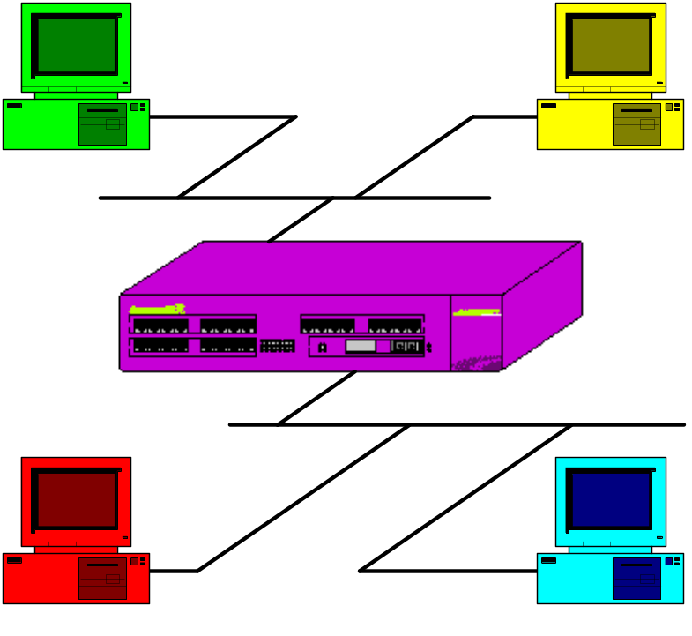
Switch Port States
Learning/Flooding
Forwarding
Filtering
Notes:
Switch Port States:
Learning / Flooding
Forwarding
Filtering
NOTE: The Rule of Flooding. Flood means you send out on all ports except the port that you received the packet from.

Slide 9
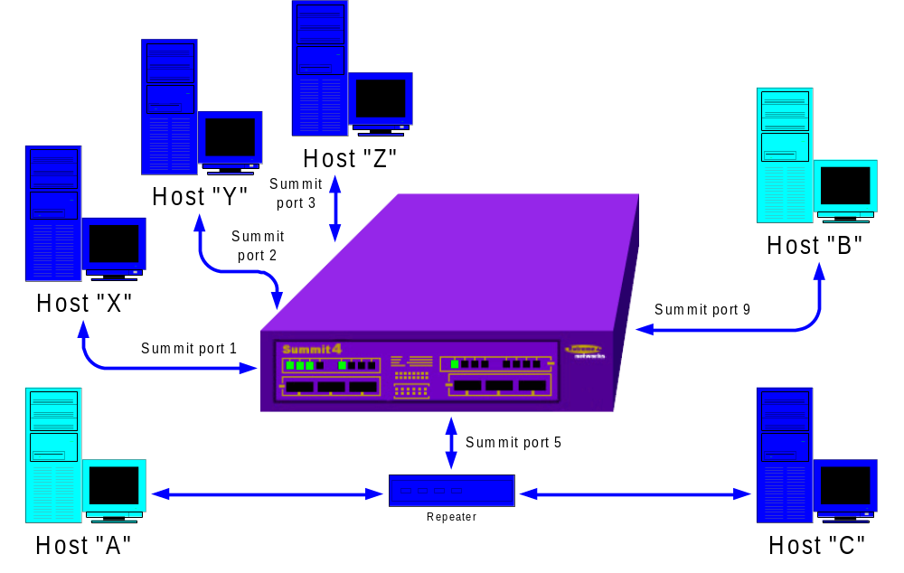
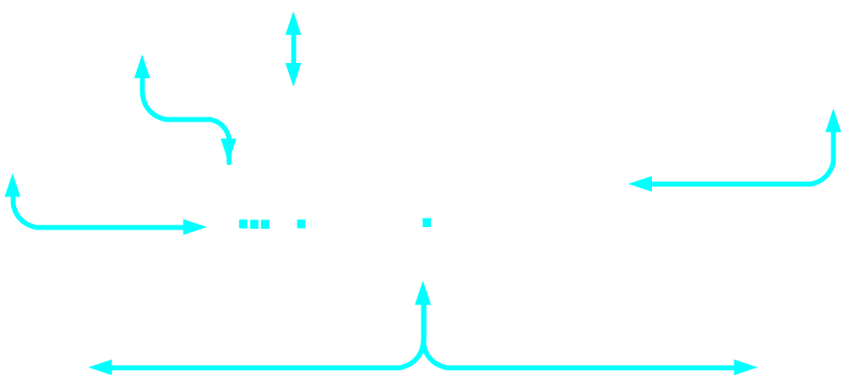
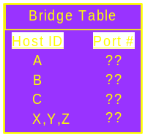
Learning/Flooding State - An Example
In a newly configured network, host “A” initiates communication with host “B”.
Because the destination is unknown, the packet is flooded to all of the interfaces and host “A” is learned on the inbound port.
Notes:
Learning/Flooding State - An Example
Node A transmits a packet to node B.
The bridge receives the packet.
Because the destination is unknown, the packet is flooded to all of the interfaces and host “A” is learned on the inbound port (an entry is added to the forwarding database).

Slide 10

Forwarding State - An Example
Host “B” replies to host “A”, and the packet is forwarded onto the destination port learned for “A”. At the same time, the MAC address for “B” is learned and added to the bridge table.
Notes:
Forwarding - An Example
Node C transmits a packet to node B.
The bridge receives the packet.
The bridge performs a forwarding table lookup on the source and destination address.
The source address already exists (previously learned).
The destination address exists.
The port ID does not match the port ID of the port that the packet was received on, therefore, the bridge forwards the received packet to port ID 2.

Slide 11
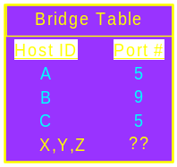
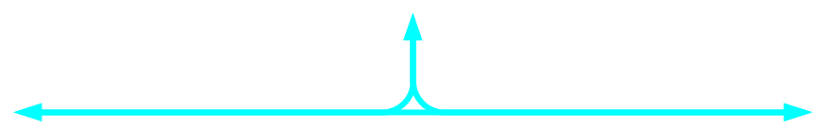
Filtering State - An Example
When the destination MAC address matches the inbound port, the switch will drop the packet at the port. This reduces traffic on the backplane and optimizes performance.
Notes:
Filtering - An Example
Node A transmits a packet to node C.
The bridge receives the packet.
When the destination MAC address matches the inbound port, the switch will drop the packet at the port. This reduces traffic on the back plane and optimizes performance.

Slide 12
ExtremeWare’s Forwarding Database
FDB is the Bridge Table
Maintains MAC addresses and the ports they were learned on
Each entry consists of:
  MAC address of the device
  Identifier for port it was received
  Identifier for VLAN the device belongs
Frames destined for devices not in the FDB are flooded to all members of the VLAN
Holds up to a maximum L2/L3 MAC entries as follows:
  256,000 – BlackDiamond with all I-series modules, Summit7i, Alpines
  128,000 – Summit1i, 5i, 48i
  32,000 – non-I series switches
Notes:
The switch maintains a database of all MAC - media access control addresses received on all of its ports. It uses the information in this database to decide whether a frame should be forwarded or filtered.
The Forwarding database holds up to a maximum of 32K entries. Each entry consists of the MAC address of the device, an identifier for the port on which it was received, and an identifier for the VLAN to which the device belongs. Frames destined for devices that are not in the FDB are flooded to all members of the VLAN.

Slide 13
FDB Entry Types
Dynamic entries
  Initially, all entries in the database are dynamic
Static Entries
  Non-aging entries
    Entries whose aging time is set to zero
  Permanent entries
    Entered via the CLI are stored as permanent
    Retained in the database even on reset/power off
    Max. 256 for Summit7i & Alpine, 512 for BlackDiamond
  Blackhole entries
    Configures packets with specified MAC destination address to be discarded.
Notes:
Possible flag values in a FDB display are:
Dynamic entries — Initially, all entries in the database are dynamic. Entries in the database are removed (aged-out) if, after a period of time (aging time), the device has not transmitted. This prevents the database from becoming full with obsolete entries by ensuring that when a device is removed from the network, its entry is deleted from the database. Dynamic entries are deleted from the database if the switch is reset or a power off/on cycle occurs.
Non-aging entries — If the aging time is set to zero, all aging entries in the database are defined as static, non-aging entries. This means that they do not age, but they are still deleted if the switch is reset.
Permanent entries — Permanent entries are retained in the database if the switch is reset or a power off/on cycle occurs. The system administrator must make entries permanent. A permanent entry can either be a unicast or multicast MAC address. All entries entered by way of the command-line interface are stored as permanent.
The Summit switch can support a maximum of 64 permanent entries, and Summit7i and Alpine 3803 = 256 permanent entries.
BlackDiamond switch supports a maximum of 512 permanent entries. (EW6.1+)
Once created, permanent entries stay the same as when they were created. For example. the permanent entry store is not updated when any of the following take place:
— A VLAN is deleted - A VLANid is changed - A port mode is changed (tagged/untagged) - A port is deleted from a VLAN - A port is disabled - A port enters blocking state - A port QoS setting is changed - A port goes down (link down).
Blackhole entries — A blackhole entry configures the switch to discard packets with a specified MAC destination address. Blackhole entries are useful as a security measure or in special circumstances where a specific destination address must be discarded. Blackhole entries are treated like permanent entries in the event of a switch reset or power off/on cycle. Blackhole entries are never aged out of the database.

Slide 14
How FDB Entries Are Added
When the switch learns entries dynamically
When user enters and updates FDB entries statically either by using:
  CLI
  MIB browser
  SNMP Manager
Notes:
Entries are added into the FDB in the following ways:
The switch can learn entries. The system updates its FDB with the source MAC address from a packet, the VLAN, and the port identifier on which the source packet is received.
You can enter and update entries using a MIB browser, an SNMP Network Manager, or the command-line interface CLI.
Configuring FDBs will follow after we define and discuss VLANs

Slide 15
FDB Configuration
create fdbentry
  create fdbentry <mac_addr> vlan <name> [ blackhole | dynamic | ports ] qosprofile <qosprofile>
  Creates a permanent FDB entry
delete fdbentry
config fdb agingtime <seconds>
  This configures the FDB aging time from 15-1,000,000 secs.
  Default is 300 seconds. A value of 0 indicates that the entry should never be aged out.
clear fdb
  Clears dynamic FDB entries matching the filter. If there are not options, the command clears all FDB entries
show fdb
Notes:
create fdbentry
Creates an FDB table entry for a specified MAC address. This command is also used to perform filtering functions (blackhole) and assign quality of service parameters to specific hosts.
delete fdbentry
delete fdbentry <mac_addr> vlan <name> [ blackhole | dynamic | ports ] qosprofile <qosprofile>
config fdb agingtime <seconds>
The above is the correct syntax.
This configures the FDB aging time from 15-1,000,000 secs.
Default is 300 seconds. A value of 0 indicates that the entry should never be aged out.
clear fdb
Clears dynamic FDB entries matching the filter. If there are not options, the command clears all FDB entries
show fdb
Displays the fdb table and entries

Slide 16
FDB Configuration Example
Create a permanent fdb entry and blackhole it for MAC=00013022a901
  create fdbentry 00 : 01 : 30 : 22 : a9 : 01 default blackhole
Verify that the entry exists
  * Summit1iTx:9 # show fdb
  Index Mac Vlan Age Flags Port List
  -------------------------------------------------------------------
  00fe0-202: FF:FF:FF:FF:FF:FF MacVlanDis(4095) 0000 s m CPU
  32880-ffb: 00:E0:2B:00:00:00 (0000) 0000 s m CPU
  5a2c0-fff: 00:01:30:22:A9:01 Default(0001) 0000 spm blackhole
  5e980-ff0: 00:01:30:C9:A6:00 Default(0001) 0000 s m CPU
  73080-200: 00:E0:2B:00:00:02 Default(0001) 0000 s m CPU
  Flags : d - Dynamic, s - Static, p - Permanent, m - MAC, i - IP, x - IPX,
  M - Mirror.
  Total: 12 Static: 12 Perm: 1 Dyn: 0 Dropped: 0
  FDB Aging time: 300 seconds
  * Summit1iTx:10 #
Notes:
If time permits, the student is encouraged to continue the FDB configuration and familiarization later on in a lab exercise.

Slide 17
Spanning Tree
802.1d - Bridging, Switching & Spanning Tree specification
Developed by DEC
  Adopted by IEEE 802.1 Network Management Committee
Allows for redundant bridging paths
Detect and reroute any broken network paths
Prevent network loops from occurring
Notes:
STP is a bridge-based mechanism for providing fault tolerance on networks. STP allows you to implement parallel paths for network traffic, and ensure that:
Redundant paths are disabled when the main paths are operational
Redundant paths are enabled if the main path fails
Spanning Tree is a protocol unto itself.
It should not be confused with the functions of a transparent bridge.
A transparent bridge make all the packet routing decisions, they are more complex and require more intelligence in the bridge.
Most bridges today are spanning tree bridges
It has been adopted by the IEEE 802 committees to run on any LAN.
NOTE:
STP is a part of the 802.1D bridge specification defined by the IEEE Computer Society. To explain STP in terms used by the 802.1 specification, the Summit Swith and BlackDiamond will be referred to as a bridge.

Slide 18
Spanning Tree Algorithm
Bridged networks must allow for redundancy
Only one path should be enabled to any destination on the network
Notes:
In the diagram above, if the network loop formed by this switches is not disabled, you will have a massive loop occurring eventually.
Within Layer2, to prevent looping, there is a need to break loops from occurring.
Thus, the rules for spanning tree are based on having
Bridged networks must allow for redundancy
Only one path should be enabled to any destination on the network
The Spanning Tree Algorithm dynamically configures a loop-free active topology from the arbitrarily connected components of a bridged LAN.
With Spanning Tree, it allows you not to have to follow a pattern when connecting the bridges together in a network.

Slide 19
Switch Ports in Active ST Topology
Certain ports are allowed to forward packets
  Other ports will participate in spanning tree but do not forward packets
These ports are called forwarding ports
Switch port/s that do not participate are placed in blocking mode
  These ports still participate in the spanning tree protocol
Notes:
Active topology is the topology of arbitrary connected components that participate in the spanning tree algorithm (protocol).
In an active Spanning Tree topology, there will be a:
Root bridge - which is the root of the spanning tree
Root port - bridge port that is toward the root bridge
Designated port - it is the bridge port that is away from the root bridge

Slide 20
Reconfiguration In Spanning Tree
Occurs when there is a change in the active topology
Link Lost
Link Restored
Notes:
Spanning tree maintains an active topology which will re-configure if there is a topology change (link up/down).
Reconfiguration of the active topology is necessary as a result of:
Network components being removed
An active bridge fails to forward packets
Management changes are made to the active topology.
In the example above, if we loose the connectivity with the original active topology maintained, the spanning tree disabled path will be restored once re-configuration is processed.
Let us try to understand what happens when a reconfiguration occurs.

Slide 21
Building Blocks of Spanning Tree
Root Bridge
Root port
Designated Bridge
Designated Port
Other Bridges and Ports
Maintaining an Active Topology
BPDU - Bridge Protocol Data Unit
Notes:
To understand how the Spanning Tree works, it is important to familiarize yourself with the terminology involved as listed above.
Each one of these will be explained in the next succeeding slides

Slide 22
How Spanning Tree Works
Root Bridge
One bridge- the one with the highest priority (lowest bridge ID) will become the root bridge
All ports on the root bridge are placed in the forwarding state
This bridge is the root (source) of spanning tree
Root Bridge
Notes:
Each Spanning Tree Domain (STPD) which we will discuss later in detail will have one Root Bridge, which will be the source of all spanning tree communications. The root bridge will be selected based on the determination among connected bridges. If there are no configuration made to affect bridge election, the bridge with the LOWEST MAC address will become the root bridge.

Slide 23
How Spanning Tree Works
Root Port
Other bridges select a port with the lowest path cost to the root bridge
  This port becomes the root port and is placed in the forwarding state
  There is only one root port per spanning tree per bridge, regardless of the number of ports in that tree.
  EXCEPTION:
    ExtremeWare allows for multiple trees per device
Root Bridge
root port
root port
root port
Notes:
In a given active topology, other bridges that are not the Root Bridge will select the port with lowest path cost toward the root bridge.
Root Port - this is the bridge port selected that is toward the root bridge
The root port is placed in the forwarding state
There is only one root port per spanning tree per bridge, regardless of the number of ports in that tree .
The exception is that ExtremeWare allows for multiple trees per device.

Slide 24
How Spanning Tree Works
Designated Bridge
Selected as the bridge that provides a LAN with the lowest path cost to the root for that individual cable segment.
Root Bridge
Designated Bridge
Notes:
The bridge that provides a LAN segment with the lowest path cost to the root is selected as the designated bridge for that individual collision domain.
The port on the designated bridge that provides the designated best path to the root bridge for the LAN segment is the designated port.

Slide 25
How Spanning Tree Works
Designated Ports
These ports are placed in the forwarding state
They are the designated best path to the root bridge
They either have workstations or branch hubs with a single connection to the network attached
Root Bridge
Designated port
Designated port
forwarding
forwarding
Designated Bridge
Notes:
Certain ports are identified as designated ports
These ports are placed in the forwarding state.
They are the designated best path to the root bridge
These ports either have workstations or branch hubs with a single connection to the network attached

Slide 26
How Spanning Tree Works
Other Bridge or Ports
Those that are not selected are placed in the blocking state.
The blocking state prevents data packets from being forwarded on that port
These ports are still participating in spanning tree for future updates
Root Bridge
Designated port
Designated port
forwarding
forwarding
blocking
blocking
Notes:
Other bridges or ports not selected have their ports placed in the blocking state.
The blocking state prevents data packets from being forwarded on that port.
These ports still participate in the spanning tree for future updates.

Slide 27
How Spanning Tree Works
Stable Active Topology
Maintained by the root bridge by transmitting configuration messages out all of its active ports
Designated bridges should receive these messages on their root port
Designated bridges should propagate the information out all of its designated ports
Root Bridge
root port
root port
root port
Designated Bridge
Notes:
The root bridge transmits configuration messages out all of its active ports. These messages carry spanning tree algorithm parameters that all bridge connected will understand.
Designated bridges should receive this messages on their root port and should propagate the information out all of its designated ports.

Slide 28
Root Bridge Determination
Each bridge, when initialized will transmit topology change messages indicating that it is the root bridge.
  All bridges will receive this information and each will save the “best” information.
  The “best” information is based on three items in the topology message:
    the Root ID field,
    the Transmitting bridge ID, and
    the cost field.
Notes:
When a network topology becomes active, upon each bridge initialization in it, each one will transmit topology change messages indicating that it is the root bridge.
All bridges will receive this information and each will save the “best” information.
The “best” information is based on three items in the topology message:
the Root ID field,
the Transmitting bridge ID, and
the cost field.

Slide 29
Root Bridge Determination (cont…)
A bridge receiving a topology message from a root bridge will perform these tests:
  If root ID of received message is of higher priority than previously saved message (including its own),
    it will discard the previously saved message and keep the new one.
  If the root IDs are equal, check the cost.
    If the cost is lower, discard previously saved message and keep the new one.
  If the root IDs and costs are equal, compare the transmitter ID.
    If the new transmitter ID is lower, the previously saved message will be discarded and the new one kept.
Notes:
Example - A bridge that receives a topology message from a root bridge will perform the following tests:
If the root ID of the received message is of a better priority than the previously saved message (including its own), it will discard the previously saved message and keep the new one.
If the root IDs are equal, check the cost. If the cost is lower, the previously saved message will be discarded and the new one kept.
If the root IDs and costs are equal, compare the transmitter ID. If the new transmitter ID is lower, the previously saved message will be discarded and the new one kept.

Slide 30

Building the Spanning Tree Domain
1,0,1
3,0,3
Bridge 1
Bridge 3
1,0,1
3,0,3
4,0,4
Bridge 4
4,0,4
6,0,6
7,0,7
Bridge 6
Bridge 7
6,0,6
7,0,7
Notes:
Calculation of the Root Bridge given RootID, Cost, Trasmitter ID
Four Ethernet segments and five bridges are to configure a loop free topology.
The first rule in STA (spanning tree algorithm) is that one bridge must become the root bridge.
Upon initialization, each bridge will transmit a topology message indicating that it is the root bridge.
The numbers on each bridge port show the root topology message that bridge sends out when determining the root bridge.
Bridge 1 will win the right to become the root bridge.
The bridge ID of bridge 1 is 1 and it is the lowest of all the bridges.
Bridge 1 will transmit its topology message as shown in the form above.
All bridges receive bridge 1’s topology message, save it, and propagate it to all other bridges.
Eventually all bridges will keep this message which identifies bridge 1 as the root.

Slide 31
Building the Spanning Tree Domain
Cable segment 4
1,0,1
Bridge 1
1,1,3
Root port
Bridge 3
Designated
bridge
Root bridge
Standby
Bridge
1,0,1
1,1,3
X
Blocking
Cable segment 3
Root port
Form: (Root ID, Cost, Transmitting bridge ID)
1,1,4
Designated
bridge
Bridge 4
1,1,4
Designated
port
Cable segment 2
Root
port
1,2,6
Bridge 6
Root port
1,2,7
Bridge 7
Designated
bridge
Standby
bridge
Designated
port
1,2,6
1,2,7
X
Blocking
Cable segment 1
Notes:
Calculation of the Participating Ports
Since the root is selected, each bridge must determine if it will become the designated bridge for any of the cable segments to which it is connected.
The root bridge places its ports in the forwarding state.
The root bridge is the designated bridge for cable segments 3 and 4.
Bridge 3 places one of its ports in the blocking state.
It is on the same cable segments as the root bridge.
Only one of its ports will be placed in the blocking state
It is based on port ID.
Bridge 4 becomes the designated bridge for cable segment 2.
It selects its root port and its designated port.
Bridge 6 and 7 have equal cost to the root.
The tie breaker is based on the transmitting bridge ID.
Transmitting bridge ID 6 is lower than 7, so bridge 6 becomes the designated bridge for cable segment 1; selects root port
Bridge 7 places one of its ports in blocking mode.
It is based on the port ID.
With a bridge that has more than two ports, it is possible for a single bridge to become designated on some cable segments to which it is connected and to place some of its other ports into blocking mode.

Slide 32
Spanning Tree Bridge Communications
BPDU - Bridge Protocol Data Unit
Configuration BPDU
Topology Change BPDU
Notes:
BPDU (Bridge Protocol Data Unit)
This is the bridge-to-bridge communications protocol to develop the spanning tree and maintain the active topology. All the bridges will continually communicate with each other to check that there is no change in the current active topology.
Configuration BPDU
This is sent to all bridges from the root bridge. It is used to determine least cost path information and determine which bridge is the root bridge. The time out information is transmitted in the configuration messages to all bridges. The timeout value accounts for propagation delay through the bridges in the spanning tree.
This is sent to the Bridge Group Address that includes all bridges that is connected to the LAN.
Topology Change BPDU
Any bridge (non-root) that changes the active topology will be transmitting the topology change BPDU.
Transmission is repeated until the bridge receives an acknowledgement BPDU message or additional reconfigurations will take place.
The acknowledgement is carried in a configuration BPDU. The root will send a topology change flag in its configuration messages for a period of time. While the root is indicating the change in the topology, all bridges age out the dynamically learned data in the filtering database (using the Forwarding Delay Time).

Slide 33
Spanning Tree Link Failure
The spanning tree topology is kept active through the transmission of BPDUs
  BPDU - Bridge Protocol Data Unit
The root bridge will transmit a Configuration BPDU on all its active ports every two seconds
Any bridge that changes the active topology will send a Topology Change BPDU message
Notes:
The topology (spanning tree) is kept active through the transmission of BPDU’s
Every two seconds the root bridge will transmit a root bridge topology message BPDU on all its active ports.

Slide 34
Spanning Tree Link Failure cont…
BPDUs are key to the Max aging timer
  The timer’s max age is 20 seconds
BPDUs reset the Max age timer on each partici-pating bridge receiving the BPDU
If 20 seconds expire,
  the bridge assumes spanning tree has failed and the bridge will go into convergence state
Reconfiguration of the active topology will occur
  if a bridge receives a topology change packet containing better information than what it has previously stored.
Notes:
The BPDUs are the key to the Max aging timer
The BPDUs reset the Max age timer on each participating bridge that receives the BPDU
The timer’s max age is 20 seconds
Upon reaching 20 seconds the bridge will assume that the tree has failed and go into a convergence state

Slide 35
Spanning Tree Link Failure
Every bridge adjacent to the Root receives the BPDU on its root port
Upon receipt of packet, each switch will retransmit its version of the BPDU with
  The root ID remaining the same
  Path Cost incremented by cost associated with the port the message is forwarded on
  Transmitting bridge ID being changed
  Message Age field being set to 0 (zero)
Notes:
Every bridge adjacent to the root will receive the BPDU on its root port.
Upon receipt of the packet, each switch will retransmit its version of the BPDU.
The root ID will remain the same
The path cost will be incremented by the cost associated with the port the message is forwarded on.
The transmitting bridge ID will be changed
The message age field is set to zero
In the situation that a link goes down, the spanning tree will have to have the failure timer expire before the tree will converge. This is to allow for transient or temporary failures. By waiting for the timer to expire, forwarding will still proceed normally until a critical link failure occurs.
In the event of a link coming back up with a better cost metric, the tree will immediately converge on the better topology. There is no timer to expire for a better topology. The next BPDU that the root transmits will converge the tree.

Slide 36
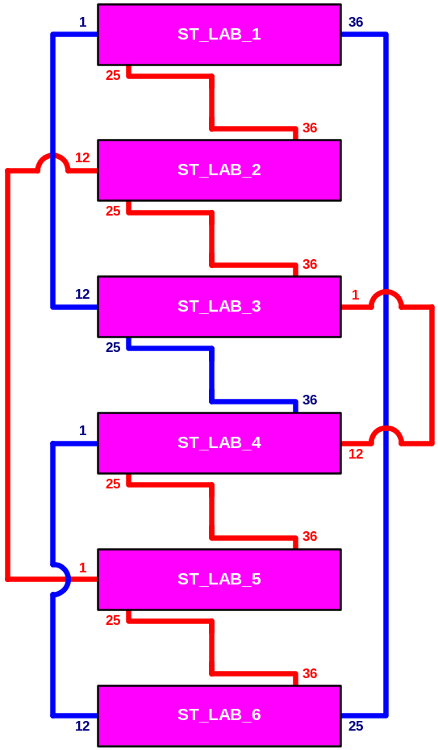
Extreme Switches and Spanning Tree
Multiple Domains
STPD
  Spanning Tree Protocol Domain
  S0 - default STPD
VLANs
Things to remember
Notes:
We have reviewed bridging concepts, spanning tree and how it works.
After learning about Bridging and spanning tree concepts, we will now discuss spanning tree and Extreme switches.
The above diagram illustrates a physical network topology that will benefit if Spanning Tree is configured to prevent broadcast storms. If you examine the diagram closely, there are physical loops that exists.

Slide 37
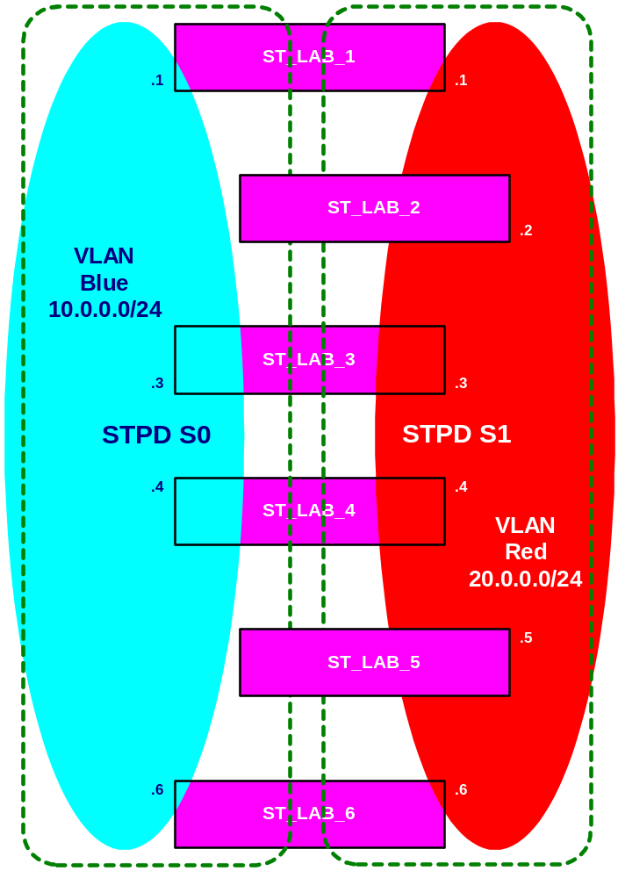
Multiple Domains and Spanning Tree
The switch can be partitioned into multiple virtual bridges
Each spanning tree instance in the switch is called an STPD
  STPD - Spanning Tree Protocol Domain or just Spanning Tree Domain
  Extreme supports 64 STPDs per switch
Each STPD has its own Root Bridge and active path
Notes:
The switch can be partitioned into multiple virtual bridges (L2 interfaces represented by vlans).
For example continuing on with the diagram in the previous slide, what is shown is a logical diagram of its equivalent.
Each spanning tree instance in the switch is called an STPD and as shown, we can configure the VLAN REDISH and VLAN BLUE to each belong to a separate STPD, namely S1 and S0 respectively
STPD - Spanning Tree Protocol Domain or just Spanning Tree Domain
Each STPD has its own Root Bridge and active path, therefore, VLAN Blue on S0 will have a root bridge and so will VLAN REDISH.
An Extreme switch can have as much as 64 STPDs per switch.

Slide 38
STPD “s0”
Default switch configuration contains one STPD called “s0” and STP is disabled .
  All VLANs created are automatically made members of “s0”
Spanning Trees have VLANs as members
You can create a new STPD
  create stpd <stpd_name>
Once the STPD is created, one or more VLANs can be assigned to it using:
  config stpd <stpd_name> add vlan <vlan_name>
You cannot delete a VLAN from “s0”, however, you can add it to another STPD
Notes:
One default STP called “s0”
By default, spanning tree is disabled on s0
Spanning Trees have VLANs as members -- VLANs are assigned to STPDs
All VLANs are automatically made members of “s0”
You cannot delete a VLAN from “s0”, but you can add it to another STPD

Slide 39
Ports, VLANs, and STPD
A VLAN can only be a member of one STPD
A physical port can belong to only one STPD
If a port is a member of multiple VLANs, then those VLANs must belong to the same STPD
Notes:
A vlan and port can belong to only one STPD. If a port is a member of multiple VLANs then all those VLANs must belong to the same STPD
If a port is a member of multiple VLANs, then those VLANs must belong to the same STPD
Care must be taken to ensure that multiple STPD instances within a single switch do not see each other in the same broadcast domain. This could happen if another external bridge is used to connect VLANs belonging to separate STPDs as an example.
Example:
VLAN orange has port 1 & 2 as member ports and belong to STPD S1
VLAN blue has port 2-4 as members and is a tagged vlan. Blue should also belong to S1 because port 2 is a member of S1 via Orange.

Slide 40
Spanning Tree Configuration Things To Consider
Draw the physical network topology
  If there is a loop anywhere, some links will get blocked
You must remove all VLANs associated with the STP before deleting the STPD
  If you delete an STPD, it will delete its member VLANs!!!
“S0” is a pre-configured STPD
STPD are blind to VLAN membership
STP, load-sharing and redundant physical port/link will work together.
All STP parameters default to IEEE 802.1D values as appropriate
Notes:
“If a port is a member of multiple VLANs, then those VLANs must belong to the same STPD”
Though simple in approach, this can lead to several configuration gotchas hence it is recommended to:
Draw the physical network; if there is a loop anywhere, some link will get blocked
Remove all VLANs associated with the STP before deleting the STPD
If you delete an STPD, it will delete its’ member VLANs!!!!!!
Care must be taken to ensure that multiple STPD instances within a single switch, do not see each other in the same broadcast domain. This could happen if, for example, another external bridge is used to connect VLANs belonging to separate STPDs.
Spanning Tree is designed for L2 environment where you can have redundant paths but only having one active path at a time to eliminate loops which eventually cause broadcast storms.
STP and load-sharing do not work together because spanning tree will never see the port, hence it cannot block them. This is no longer true with Rel. 4.1.11.
STP and the redundant physical port/link will work well together.

Slide 41
Things To Remember VLANs and STP
Each VLAN forms an independent broadcast domain
STP blocks paths to create a loop free environment
  No data can be transmitted/received on an STP blocked port
Within any given STP Domain (STPD), all VLANs belonging to it use the same spanning tree
When assigning VLANs to an STPD
  Pay careful attention to the STP configuration and its effect on the forwarding of VLAN traffic
Notes:
The key points to remember when configuring VLANs and STP are the following:
Each VLAN forms an independent broadcast domain
STP blocks path to create a loop-free environment
When STP blocks a path, no data can be transmitted or received on the blocked port.
Within any given STPD, all VLANs belonging to it use the same spanning tree.

Slide 42
Configuring STP on the Switch
Create one or more unique named STP domains
  create stpd <stpd_name>
  Example: create stpd S1
Add one or more VLANs to the STPD
  config stpd <stpd_name> add vlan <vlan_name>
  Example: create stpd S1 add vlan default
Enable STP for one or more STP domains
  enable stpd { <stpd_name> }
  Example: enable S1
Verify configuration parameters
  show stpd { <stpd_name> }
  Example: show S1
Notes:
To configure STP, you must perform the following actions:
1- Create one or more unique named STP domains using the CLI command:
Create stpd <stpd_name>
NOTE: STPD, VLAN and QoS profile names must all be unique. For example, a name used to identify a VLAN cannot be used when you create an STPD or a QoS profile.
2- Add one or more VLANs to the STPD using the CLI command:
Config stpd <stpd_name> add vlan <vlan_name>
3 – Enable STP for one or more STP domains using the following comman:
Enable stpd { <stpd_name> }

Slide 43
Configuring STP Parameters
Parameters that can be configured per STPD
  Hello time
  Forward delay
  Max Age
  Bridge Priority
Parameters that can be configured per port
  Path cost
  Port priority
Caution:
  Configure STP parameters only if you have considerable knowledge and experience with STP.
Notes:
Once you have created STPDs, you can optionally configure STP parameters for each STPD based on your particular network needs.
CAUTION:
You should not configure an STP parameters unless you have considerable knowledge and experience with STP. The default STP parameters are adequate for most networks.
Parameters that can be configured per STPD
Hello time
Forward delay
Max Age
Bridge Priority
Parameters that can be configured per port
Path cost
Port priority
NOTE:
The switch supports the RFC 1493 Bridge MIB. Parameters of only the s0 default STPD are accessible through this MIB.

Slide 44
STP Configuration CLI Commands
create/delete stpd
enable/disable stpd
enable/disable stpd port
config stpd add vlan
config stpd priority
config stpd port cost
config stpd port priority
config stpd hellotime
config stpd forwarddelay
config stpd maxage
unconfig stpd
show stpd
show stpd port
enable ignore-stp vlan <name>
Notes:
In the current release of ExtremeWare, the following are the Spanning Tree Command Line Interface (CLI) commands that can be used.
create/delete stpd
enable/disable stpd
enable/disable stpd port
config stpd add vlan
config stpd priority
config stpd port cost
config stpd port priority
config stpd hellotime
config stpd forwarddelay
config stpd maxage
unconfig stpd
show stpd
show stpd port

Slide 45
CLI Command - create/delete stpd
create stpd <stpd_name>
delete stpd <stpd_name>
  Creates an STPD. When created, an STPD has the following default parameters:
    Bridge priority — 32,768
    Hello time — 2 seconds
    Forward delay — 15 seconds

Slide 46
CLI Command - enable/disable stpd
enable stpd <stpd_name>
disable stpd <stpd_name>
  Enables / disables the STP protocol for one or all STPDs.
  The default setting is disabled.
Notes:
Spanning Tree is enabled by default on the port but disabled by default on the switch.

Slide 47
CLI Command - enable/disable stpd port
enable stpd <stpd_name> port <portlist>
disable stpd <stpd_name> port <portlist>
  Enables / disables the STP protocol on one or more ports. If STPD is enabled for a port, BPDUs will be generated on that port if STP is enabled for the associated STPD.
  The default setting is enabled.

Slide 48
CLI Command - config stpd add vlan
config stpd <stpd_name> add vlan <name>
  Adds a VLAN to the STPD. A VLAN cannot be a member of more than one spanning tree domain.

Slide 49
CLI Command - config stpd priority
config stpd <stpd_name> priority <value>
  Specifies the bridge priority in the STPD. By changing the priority, the bridge can be configured to be more or less likely elected the Root Bridge.
  The range is 0 through 65,535.
  The default setting is 32,768. A setting of 0 indicates the highest priority.

Slide 50
CLI Command - config stpd port cost
config stpd <stpd_name> port cost <value> <portlist>
Specifies the path cost of the port in this STPD.
The range is 1 through 65,535. The switch
automatically assigns a default path cost based on the speed of the port, as follows:
    For a 10Mbps port, the default cost is 100.
    For a 100Mbps port, the default cost is 19.
    For a 1000Mbps port, the default cost is 4.

Slide 51
CLI Command - config stpd port priority
config stpd <stpd_name> port priority
<value> <portlist>
  Specifies the priority of the port in this STPD. By changing the priority of the port, you can make it more or less likely to become the Root Port.
  The range is 0 through 31.
  The default setting is 16. A setting of 0 indicates the lowest priority.

Slide 52
CLI Command - config stpd hellotime
config stpd <stpd_name> hellotime <value>
  Specifies the time delay (in seconds) between the transmission of BPDUs from this STPD when it is the Root Bridge.
  The range is 1 through 10 and the default setting is 2 seconds

Slide 53
CLI Command - config stpd forwarddelay
config stpd <stpd_name> forwarddelay <value>
  Specifies the time (in seconds) that the ports in this STPD spend in the listening and learning states when the switch is the Root Bridge.
  The range is 4 through 30.
  The default setting is 15 seconds.

Slide 54
CLI Command - config stpd maxage
config stpd <stpd_name> maxage <value>
  Specifies the maximum age of a BPDU in this STPD.
  The range is 6 through 40.
  The default setting is 20 seconds.
  Note that the time must be greater than, or equal to 2 X (Hello Time + 1) and less than, or equal to 2 X (Forward Delay –1).

Slide 55
CLI Command - unconfig stpd
unconfig stpd <stpd_name>
Restores default STP values to a particular STPD or to all STPDs.

Slide 56
CLI Command - show stpd
show stpd {<stpd_name>}
Displays STP information for one or all STP domains.
Summit1i:1 # sh s0
Stpd: s0 Stp: DISABLED Number of Ports: 8
Ports: 1,2,3,4,5,6,7,8
Vlans: default1 MacVlanDiscover default
Bridge Priority: 32768
BridgeID: 80:00:00:01:30:c9:a6:00
Designated root: 00:00:00:00:00:00:00:00
RootPathCost: 0 Root Port: ----
MaxAge: 0s HelloTime: 0s ForwardDelay: 0s
CfgBrMaxAge: 20s CfgBrHelloTime: 2s CfgBrForwardDelay: 15s
Topology Change Time: 35s Hold time: 1s
Topology Change Detected: FALSE Topology Change: FALSE
Number of Topology Changes: 0
Time Since Last Topology Change: 0s
Summit1i :2 #
}
If this matches, then this is the ROOT Bridge
Notes:
Show stpd command displays the following information:
STPD name
Bridge ID
STPD configuration information
If the Bridge ID and the Designated Root matches, then this switch is the root Bridge.

Slide 57
CLI Command - show stpd port
show stpd {<stpd_name>} port <portlist>
Displays the STP state of a port.
* Summit24:6 # show stpd s0 port 1
Stpd: s0 Port: 1 PortId: 8001 Stp: ENABLED Path Cost: 100
Port State: FORWARDING Topology Change Ack: FALSE
Port Priority: 128
Designated Root: 00:00:00:00:00:00:00:00 Designated Cost: 0
Designated Bridge: 00:00:00:00:00:00:00:00 Designated Port Id: 0
Press <SPACE> to continue or <Q> to quit:
Notes:
To display the STP state of a port, use the following command:
show stpd <stpd_name> port <portllist>
This command displays the following:
STPD port configuration
STPD state (Root Bridge, and so on)
STPD port state (forwarding, blocking, and so on)

Slide 58
CLI Command - enable ignore-stp vlan
enable ignore-stp vlan <vlan_name>
Configures the switch to ignore the spanning tree protocol. This command is useful when multiple VLANs share the same physical ports, but only some of the VLANs require STP protection.
The default setting is disabled.
Notes:
This command is very useful when you want to selectively choose which VLAN will participate in spanning tree without reconfiguration or physical changes on the network topology.

Slide 59
Lab Exercises
Lab 11 – FDB Familiarization – (Interactivity)
  This exercise will enable students to be familiar with the Forwarding Database (FDB) and CLI commands to configure it.
Lab 12 - Spanning Tree Configuration
  This exercise will enable students to be familiar with the Spanning Tree Protocol and how to configure it on an Extreme switch.

Slide 60
Lab11 – FDB Familiarization
Create several FDB entries
Verify that the entries exist in the FDB
Do some more FDB configuration commands with your neighbors

Slide 61
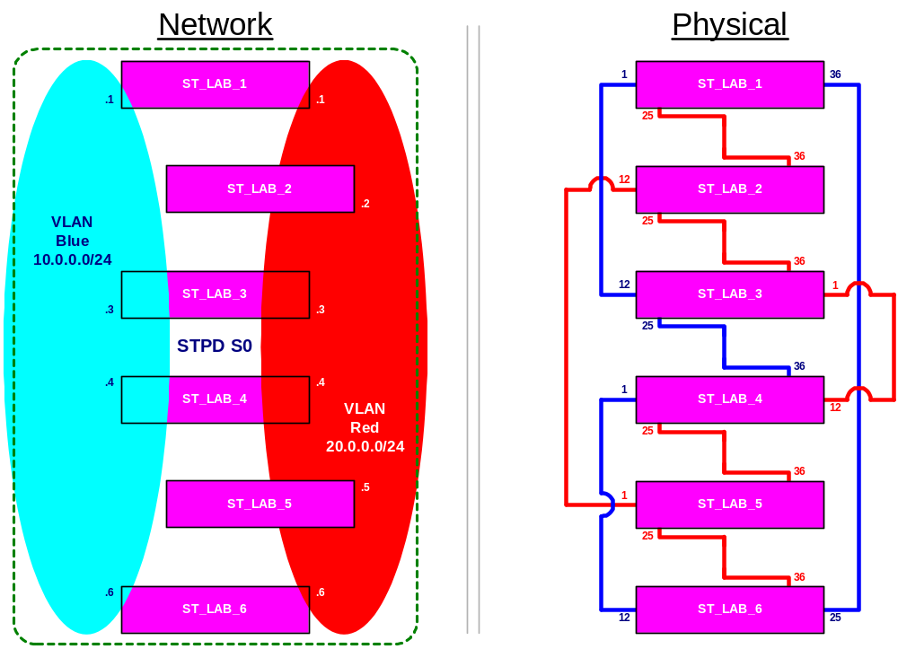
Lab 12 - Spanning Tree
Notes:
In this lab exercise, the student will be configuring a Spanning Tree Domain called S0 with a new set of configuration. All switch should be placed in factory default setting before starting.
It is important that before enabling STP, that all switches are ready.
Reference instructions in the lab procedures.

Slide 62
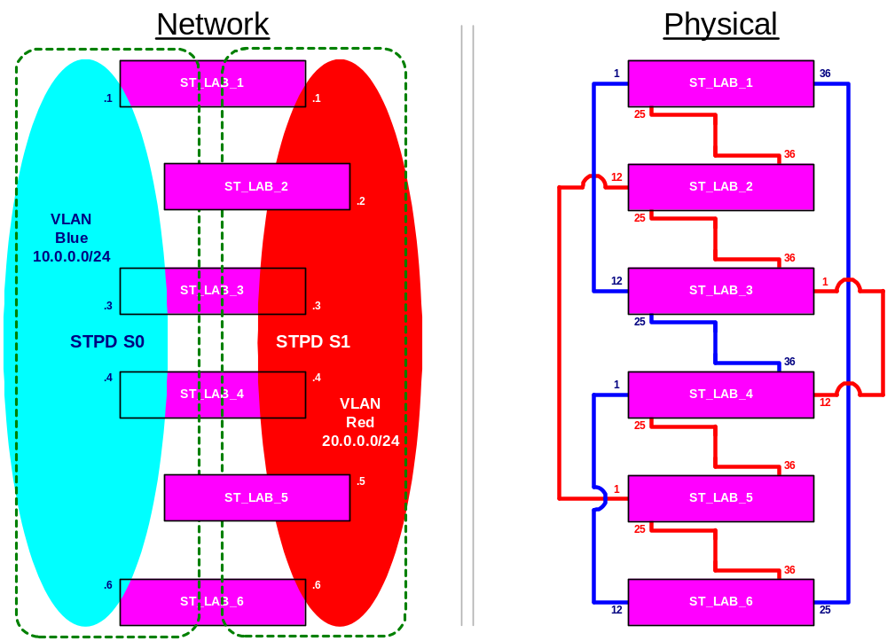
Lab 12 - Spanning Tree cont… (Opt)
Notes:
This second Spanning Tree Lab exercise, the student will be configuring a second spanning tree domain called “S1” for STPD 1. You will move the root bridge from being SW4 to another switch - SW6.
Reference the instructions in the lab procedures.

Slide 63
Summary
Discuss Layer2 Briding Concepts
Define the Forwarding Database - FDB
Describe FDB CLI configuration commands
Discuss Spanning Tree Protocol in an overview
Determine the Building blocks of STP
Describe Ports, VLANs, STPD relationship
Learn how to configure STP on an Extreme Switch
Perform Lab Exercises on FDB and STP Configuration

Slide 66
DETERMINE IF YOU WANT THESE LABS!!!

Slide 67
Lab Exercise
Lab 5 - Bridging and VLANs Configuration I
Notes:
1) Create two discreet broadcast domains, VLAN red and blue.
2) Provide link for the interfaces either by adding the laptop, or by using a cross-over cable to an unassigned port. The cross connect cable should be in one port on vlan created, the other one on a port not on the VLAN. (This is because the Vlan created must have at least one port that has an active link in it).
Vlan Blue will have uplink from laptop to port 16
Vlan Red will have uplink using cross-connect cable bet. Port 1 & 2
3) Check connectivity.
4) Look at the management information provided in the IP configuration display.
5) Investigate switch anomaly with ARP resolution.
6) Do the Lab # that corresponds to your switch #
7) Be sure to delete all ports from vlan DEFAULT before proceeding, otherwise, when you create a vlan, it will give you an error pertaining to the port - this was a warning ahead of time!
8) Add to the lab- plug the laptop into port 12 vlan Blue.

Slide 68
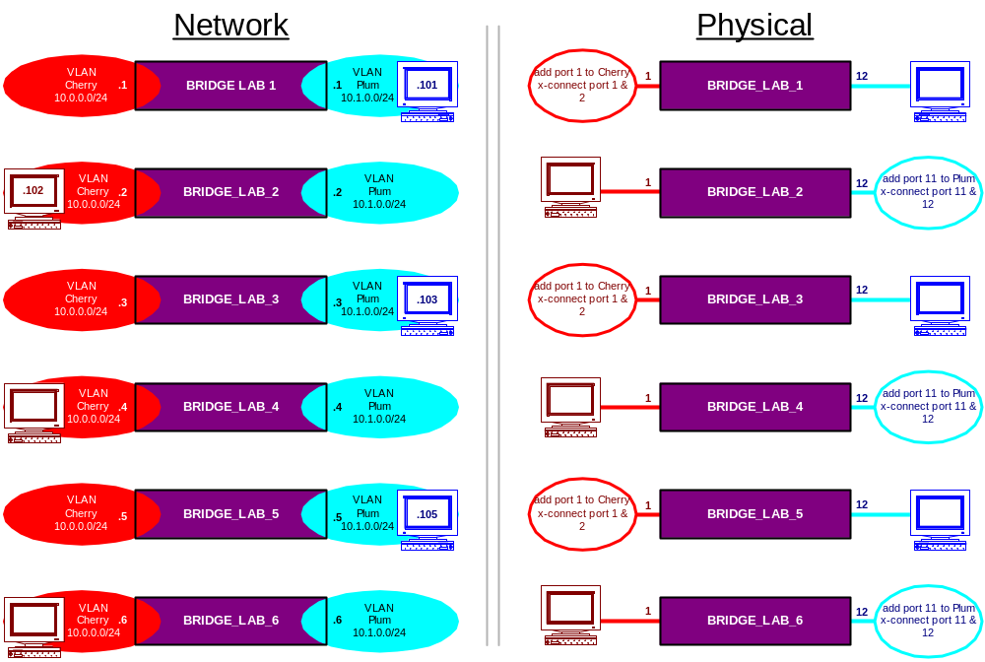
Lab 5 - Network Topology

Slide 69
Lab Exercise
Lab 6 - Bridging and VLANs Configuration II
Notes:
1) Add ports for switch interconnection to red and blue.
2) Cable up the switches and check for logical continuity.
3) Explore the switch management information (FDB).

Slide 70
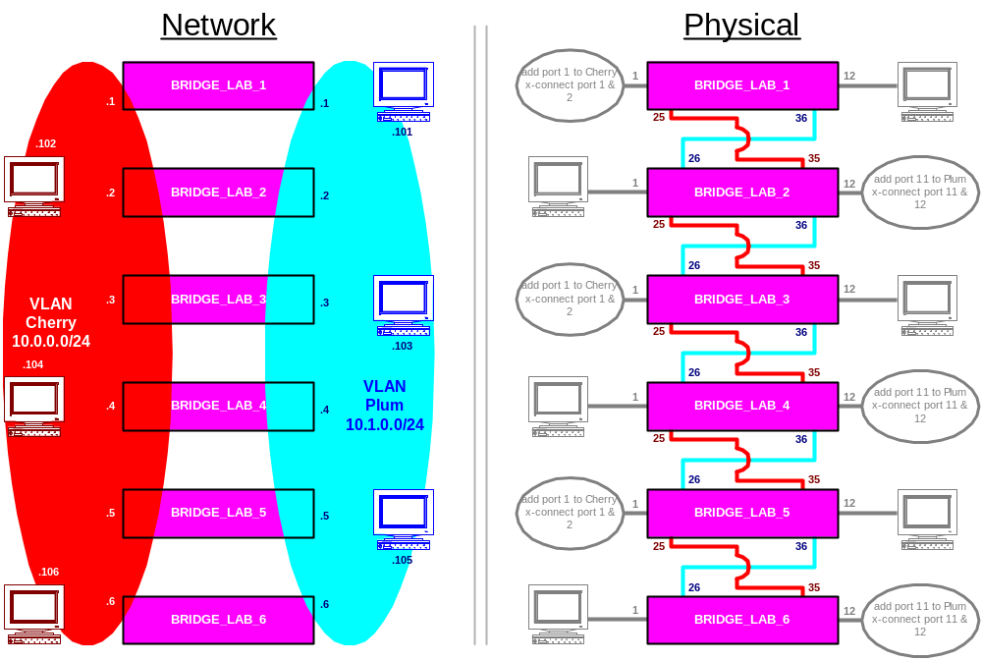
Lab 6 - Network Topology

Slide 71
Lab Exercise
Lab 7 - VLAN Configuration with Tags

Slide 72
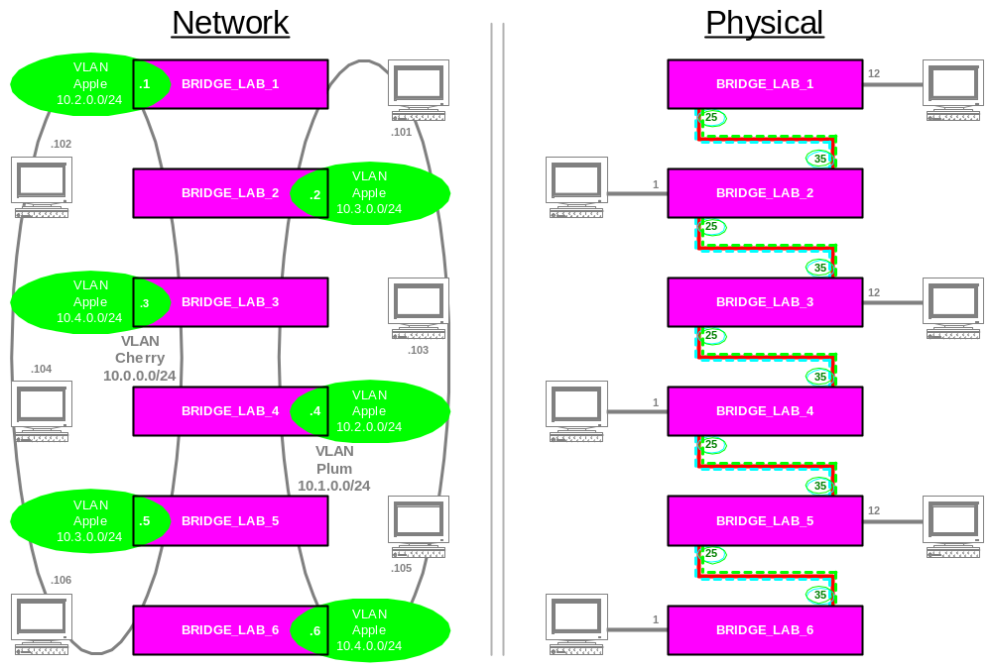
Lab 7 - Network Topology
Notes:
Note: Purpose of exercise it to point out that VLAN names, IP subnets and tag values are independent of each other.
The broadcast domain Apple is intact throughout all six switches, however, only those switches within the same IP subnet will be able to talk to each other.
Broadcast traffic, however, from the different IP subnets in Apple will be seen by everyone.
In a nutshell, tag values must match end-to-end. Both ports on either side of a trunk need to be set to use tagging(tagged) or not (untagged)

Slide 73
Lab Exercise
Notes:
Instructor Note: In earlier versions of this class, this was formally Lab #13. It has been moved to this point in the course.
Therefore, this lab will require students to configure an ipaddress and VLANs. A detailed lab on VLANs is covered at the beginning of Lab 6: Bridging & Configuration I

Slide 74
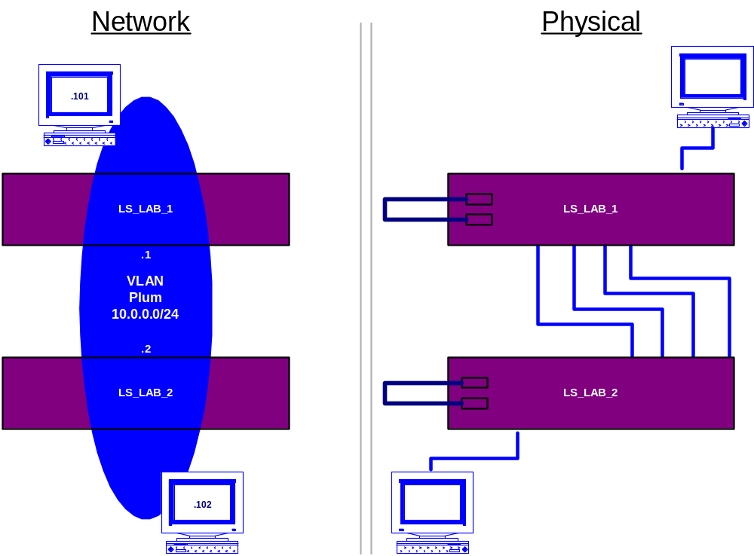
Lab 8 - Load Sharing Configuration
Notes:
This Lab Exercise is performed between pairs of switches, I.e., Switch1 & Switch2, Switch3 & Switch4, and Switch5 & Switch6.
The network topology for each pair is shown in the lab procedures.
Shown above is the topology for SW1 and SW2.

